Slide 1



Cyber Defensive Capability Performance Measurement Development Challenge AI-enhanced Cyber Resiliency Evaluation System (ACRES) October 22 – 23, 2024
Roncs Etame-Ese, Richard M. Flores II, Claire Kamobaya, Natasha K. Menon, and Charles “Matt” Penn,
Marymount University
College of Business, Innovation, Leadership, and Technology

Slide 2
Challenge Demonstration Introduction
Challenge Team Members
Name | Major | Challenge Project Role
Roncs Etame-Ese | D.Sc. Cybersecurity | Data Set Identification and Data Serialization, Developer
Richard M. Flores II | B.S. Information Technology | S.U.E. Data Serialization, Developer (NVD Data, Algorithm)
Claire P. Kamobaya | B.S. Cybersecurity | A.I. Model Researcher and Technical Writer/Documentation, Developer
Natasha K. Menon | B.S. Computer Science | GUI Data Visualization, Scrum Master, Developer (GUI, Algorithm)
Charles “Matt” Penn | B.S. Cybersecurity | A.I. Deployment, Developer (System Scoring, Threat Scoring)
Challenge Academic Advisors
Name | Department | Telephone Number
Alex V. Mbaziira, PhD | Director, School of Technology and Innovation | 703-908-7508
Diane R. Murphy, PhD | Director, Center for the Innovative Workforce | 703-284-5958

Slide 3
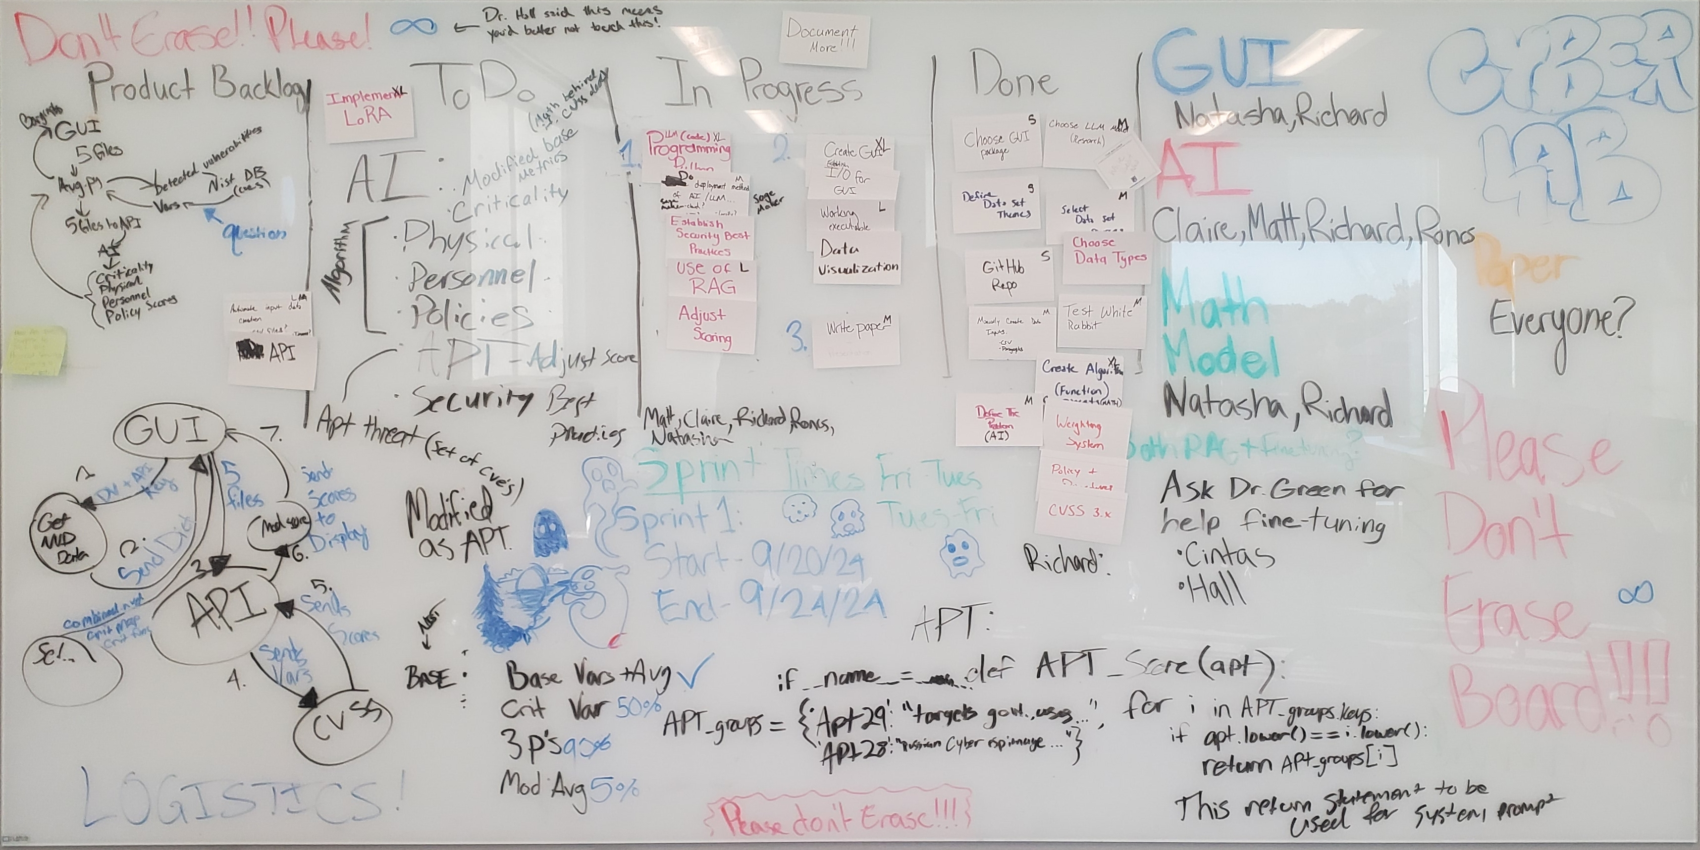
Challenge Assumptions & Constraints
Challenge Project Assumptions
No. | Assumption Description
1 | A.I. Model is open-source and publicly available for download
2 | GUI shows users visualized data that is easily inputted and digested
3 | Scrum is used to complete tasks in a timely manner where we can readjust if needed
4 | Dataset identifying patterns, correlations, and relationships between different variables
Challenge Project Constraints
No. | Constraint Description
1 | Limited processing power for local machines
2 | Context window constraints for the local Groq API, limits max tokens to 8K
3 | Adjusting the widgets in the GUI to be in the correct placement
4 | Weighing and shifting the mathematical model correctly output a cyber resiliency score
5 | Relying on third parties (NIST NVD, Groq, Llama) sometimes causes issues when throttled, or they have other service issues.
Notes:
Constraints 1. Many of our laptops and local machines we use does not have sufficient CPUs or GPUs to handle the complex computations required by LLMs. This can be due to insufficient memory and storage limitation.

Slide 4
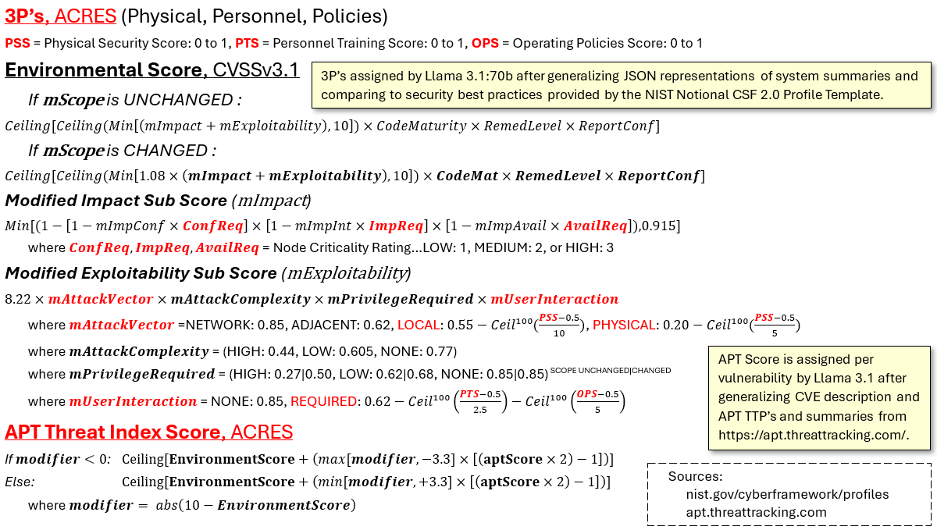
Challenge Solution Overview
Our algorithm uses a combination of A.I. assigned subscores and logically derived subscores to calculate the cyber resiliency score. CVSSv3.1 Environmental score is slightly modified, and ACRES expands on it.

Slide 5











Challenge Solution Overview
Solution architecture.
GUI is started from executable
JSON files and API are selected in GUI
JSON files and API keys are passed to orchestration module
NIST NVD API is called to provide data for CVE's
Groq API calls Llama 3.1 to calculate 3P's for system
Groq API calls Llama 3.1 to calculate APT score per CVE
Calculations module is called to calculate scores
Averaging module is called to average scores
GUI indicates score
Report module can be called

Slide 6
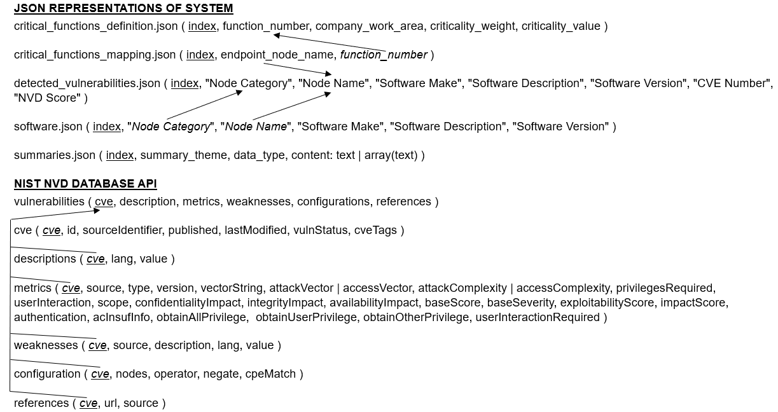
Challenge Solution Overview
While not currently implemented as a database, our JSON representation of the system uses a database schema to interact with eachother and link the different themes. The NIST NVD database is also used.

Slide 7
Challenge Solution Overview
Artificial Intelligence/Machine Learning Usage
Two AI solutions utilizing Grog API to call Llama 3.1 70B model
First model: Generates scores for physical security, personnel, & policies
AI model is given 2 documents to analyze.
Model reads security best practices and compares summaries of the SUE.
Generates score of 0 = worst OR 1 = best.
Results returned for final system score.
Second model: Gauges severity of vulnerabilities based on given APT
File accepts a given APT & dictionary of CVE's.
Given APT compares file of APT's and their TTP's
If there's a match, AI model provides APT along with associated TTP's
Likelihood score is assigned to CVEs for APT exploitation with scores & explanations
What Change:
Reason for not fine-tuning: Preparing time and cost were significant factors.
Alternative Approach: Instead of using our own fine-tuned LLM in SageMaker, we decided to use API.

Slide 8
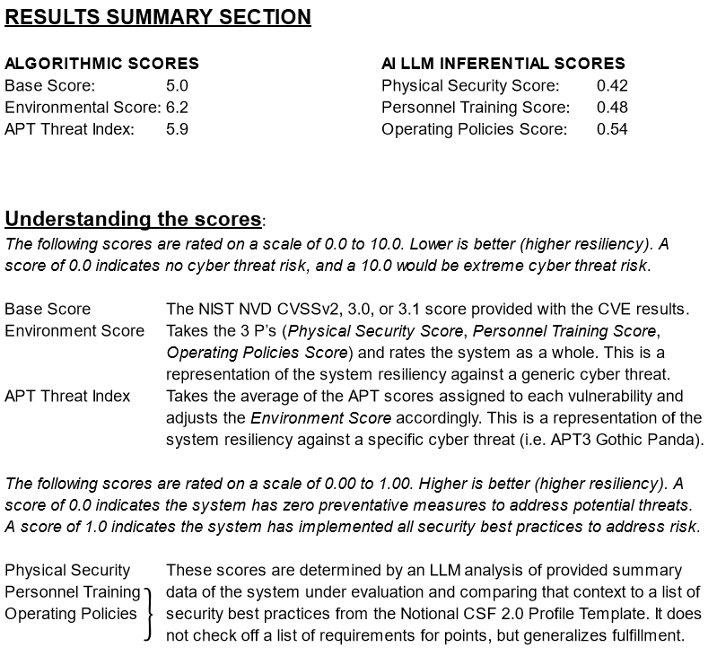
Challenge Solution Overview
SCORING RANGES
ALGORITHMIC
SCORES
0.0 to 10.0
LOWER is better
INFERENTIAL
SCORES
0.0 to 1.0
HIGHER is better

Slide 9
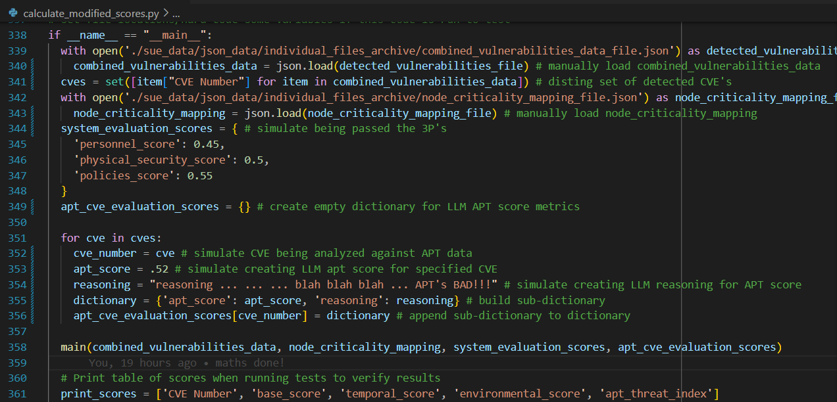
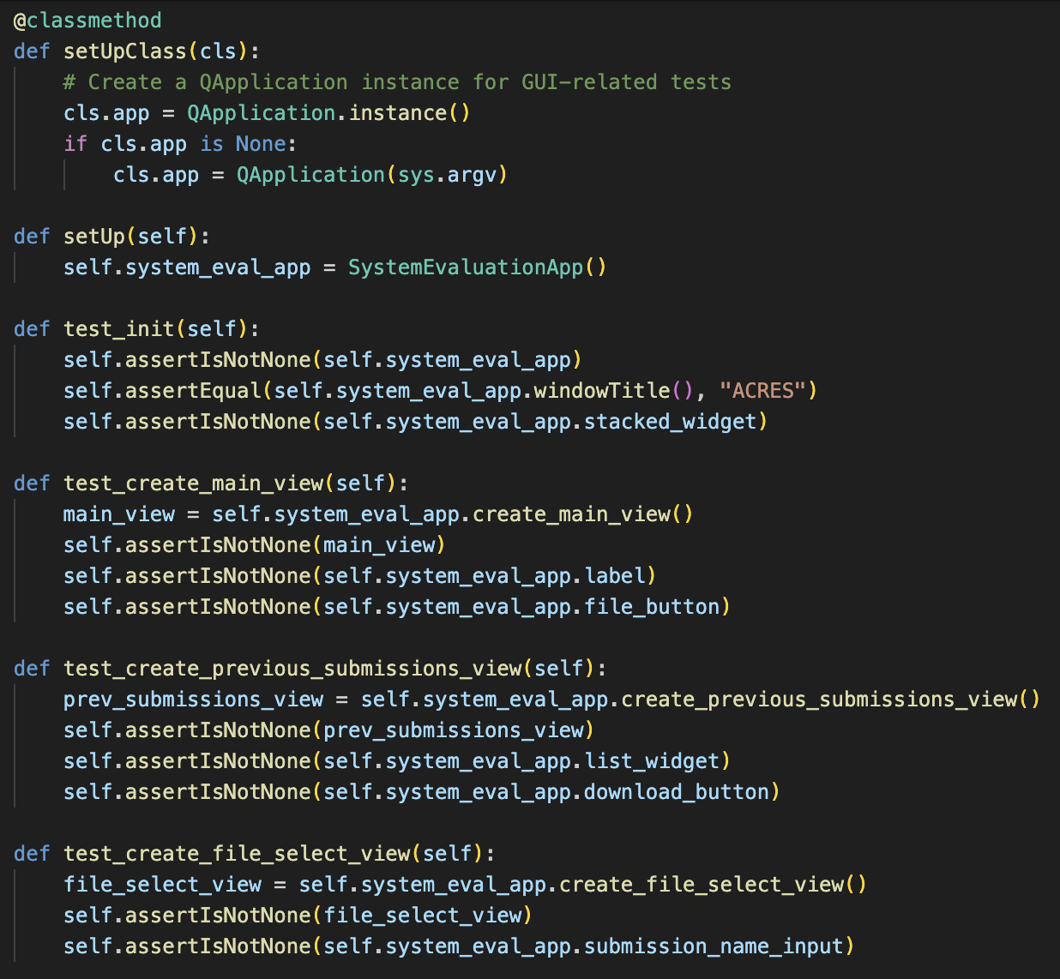
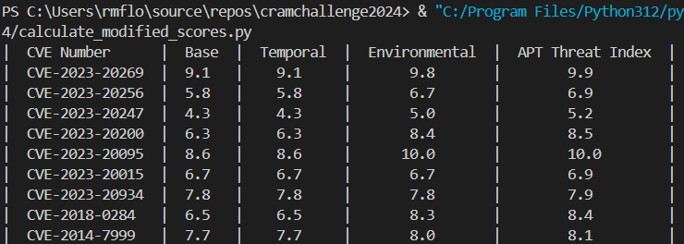
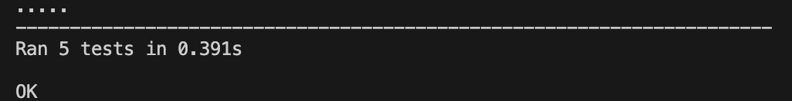
Challenge Solution Verification Test Method
Modules were developed to function individually, attempting to maintain one theme per module.
If __name__ == "__main__" code blocks were utilized to test inputs and outputs independent of other code.
Debugging print() and input() statements were used to debug, track progression, and verify sequencing.
Unit testing was performed on modules.

Slide 10
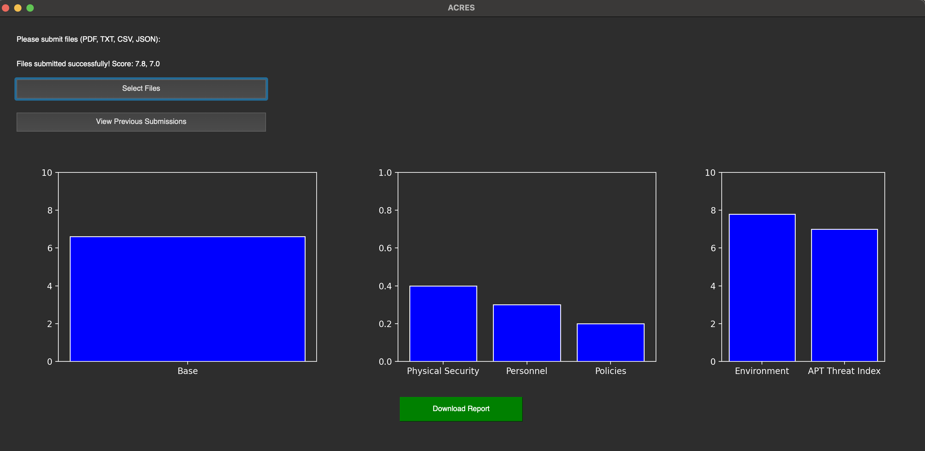
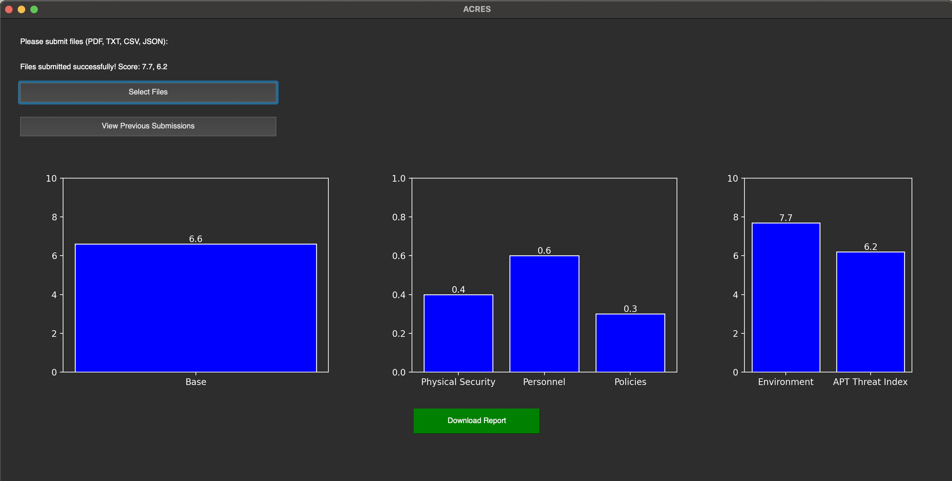
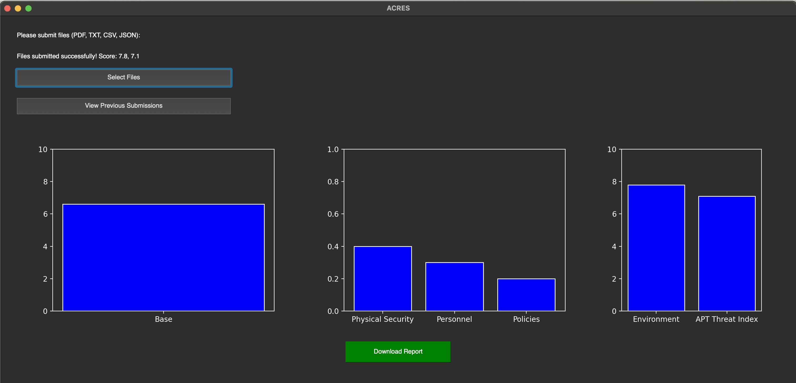
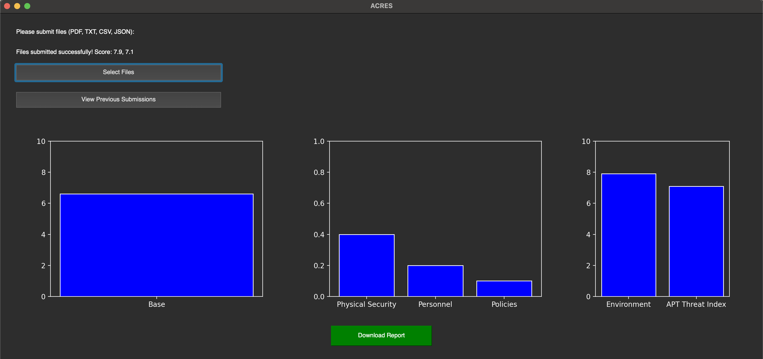
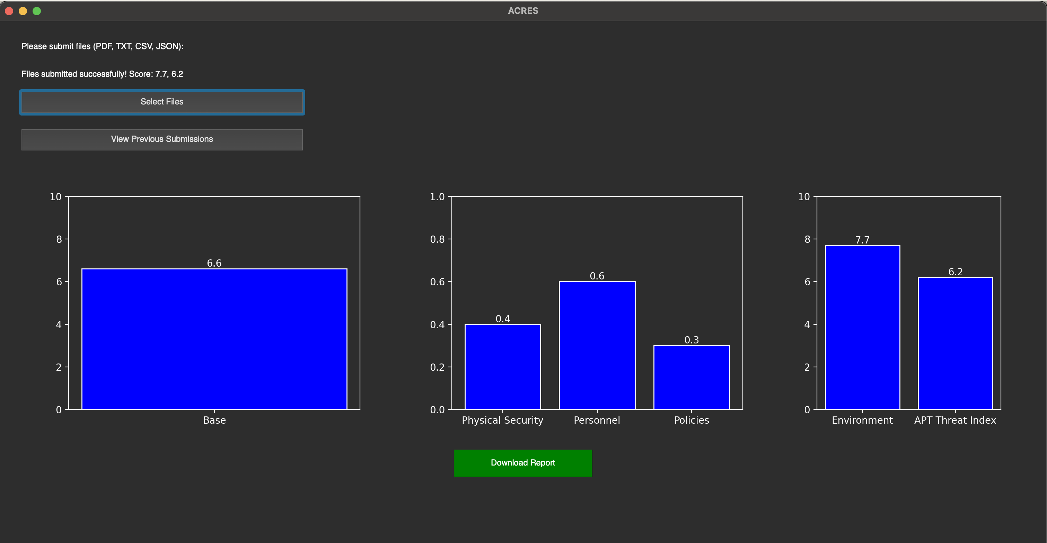
Challenge Solution Verification Test Method
Once code development was complete, we integrated the code with all three Python coders performing a code review and merging selected files / lines of code into a final testing branch, followed by test runs of the code to check for integration errors, functionality discrepancies, and ensure consistent, repeatable scoring.
APT37, Reaper, North Korea
RUN TIMES | ENV | APT
1 min 59 sec | 7.7 | 6.2
2 min 8 sec | 7.8 | 6.4
2 min 9 sec | 7.7 | 6.2
APT3, Gothic Panda, China
RUN TIMES | ENV | APT
2 min 3 sec | 7.8 | 7.0
2 min 8 sec | 7.8 | 7.1
2 min 13 sec | 7.9 | 7.1

Slide 11
Challenge Solution Demonstration Overview
DEMONSTRATION STEPS
GUI is started from executable
JSON files and API are selected in GUI
JSON files and API keys are passed to orchestration module
NIST NVD API is called to provide data for CVE's
Groq API calls Llama 3.1 to calculate 3P's for system
Groq API calls Llama 3.1 to calculate APT score per CVE
Calculations module is called to calculate scores
Averaging module is called to average scores
GUI indicates score
Report module can be called
Remove a detected CVE
Re-run steps 1 through 10
The score should change
If a low threat CVSS scored CVE is removed, score should remain similar, or slightly increase
If a high threat CVSS scored CVE is removed, score should decrease
If a CVE is removed from a high criticality system, score should decrease
If a CVE is removed from a hight criticality system, and it is high CVSS score, score should decrease substantially.
CVSS Base Score average is 6.6 for provided CVE's; scores should adjust accordingly

Slide 12

Challenge Solution Demonstration Overview
THANK
YOU!
Roncs Estame-Ese
Richard M. Flores II Claire P. Kamobaya Natasha K. Menon Charles Matthew Penn

